Slide 1

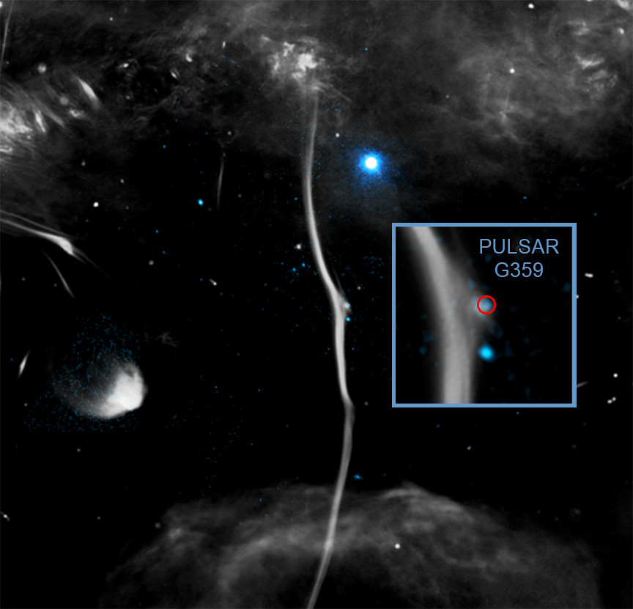

Chandra Science Highlight
NASA's Chandra Diagnoses Cause of Fracture in Galactic "Bone"
A galactic ‘bone’ has been fractured by a speeding pulsar according to data from Chandra and radio telescopes.
Known officially as G359.13142-0.20005 (G359.13 for short), this is one of several enormous structures that resemble bones or snakes found near the center of the Milky Way.
Researchers think the pulsar likely caused the fracture when it smashed into G359.13 at a speed between one and two million miles per hour.
The collision distorted the magnetic field in the bone, causing the radio signal to also become warped.
Distance estimate: 26,000 light-years
Credits: X-ray: NASA/CXC/Northwestern Univ./F. Yusef-Zadeh et al; Radio: NRF/SARAO/MeerKat; Image Processing: NASA/CXC/SAO/N. Wolk
Instrument: ACIS
Reference: Yusef-Zadeh, F. et al, 2024, MNRAS, 530, 254; DOI:10.1093/mnras/stae549
More information: The detailed caption and other graphics material are here:
https://chandra.si.edu/photo/2025/bone/
This new image shows G359.13142-0.20005 (G359.13 for short), with X-ray data from Chandra (colored blue) and radio data from the MeerKAT radio array in South Africa (colored gray). Researchers also refer to G359.13 as the Snake. This image reveals the presence of a break, or “fracture”, in the otherwise continuous length of G359.13 seen in the image. An X-ray and radio source at the location of the fracture is a likely pulsar responsible for this break, which smashed into G359.13 and distorted the magnetic field in the bone, causing the radio signal to also become warped.
The Chandra X-ray Center is operated for NASA by the Smithsonian Astrophysical Observatory
April 2025

