Slide 1

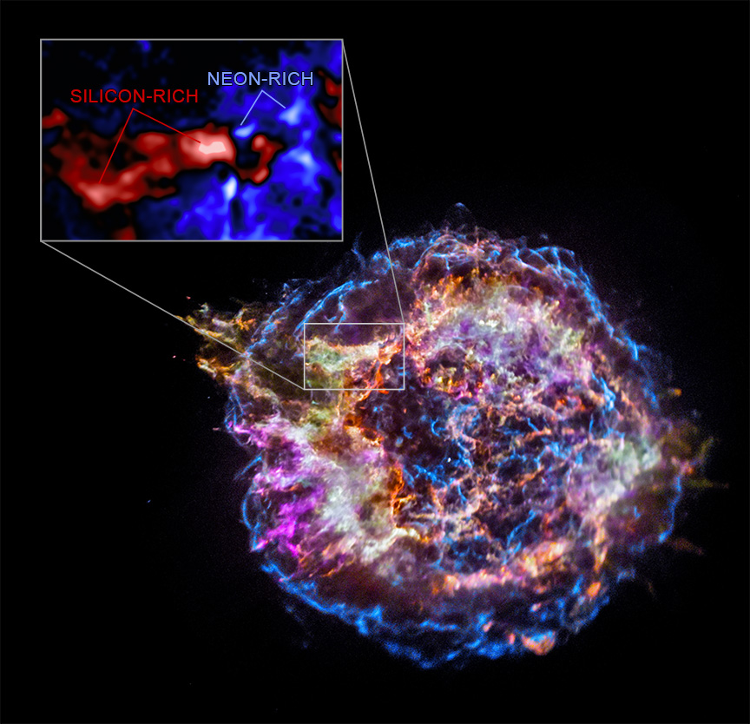

Chandra Science Highlight
NASA's Chandra Reveals Star's Inner Conflict Before Explosion
The star that exploded to form the Cassiopeia A (Cas A) supernova remnant appears to have undergone dramatic changes right before its demise.
New evidence from NASA’s Chandra X-ray Observatory indicates that layers of elements in the star’s interior were violently rearranged just hours before the explosion.
Areas in the Chandra data with large amounts of silicon but small amounts of neon, and nearby regions with the opposite abundances, contain records of the star’s internal rearrangement.
This result has implications for understanding how massive stars explode at the end of their lives and what becomes of their remains.
Chandra has observed Cas A repeatedly for more than a quarter century and continues to deliver new findings.
Distance estimate: 11,000 light-years
Credits: X-ray: NASA/CXC/Meiji Univ./T. Sato et al.; Image Processing: NASA/CXC/SAO/N. Wolk
Instrument: ACIS
Reference: Sato, T. et al, 2025, Accepted; arXiv:2507.07563
More information: The detailed caption and other graphics materials are here: https://chandra.harvard.edu/photo/2025/casa/
The main panel of this graphic is Chandra data of Cas A that shows the location of different elements in the remains of the explosion: silicon (red), sulfur (yellow), calcium (green) and iron (purple). The blue color reveals the highest-energy X-ray emission, highlighting the expanding blast wave from the supernova explosion. The inset to the upper left zooms in a smaller region of Cas A. Using different colors from the main image, this reveals Chandra data that shows relative amounts of silicon and neon. Areas with large amounts of silicon but smaller amounts of neon are labeled as silicon-rich, and are colored red. Alternatively, areas where Chandra detects the opposite — large amounts of neon but smaller amounts of silicon – are labeled as neon-rich and are blue.
The Chandra X-ray Center is operated for NASA by the Smithsonian Astrophysical Observatory
August 2025

