Slide 1

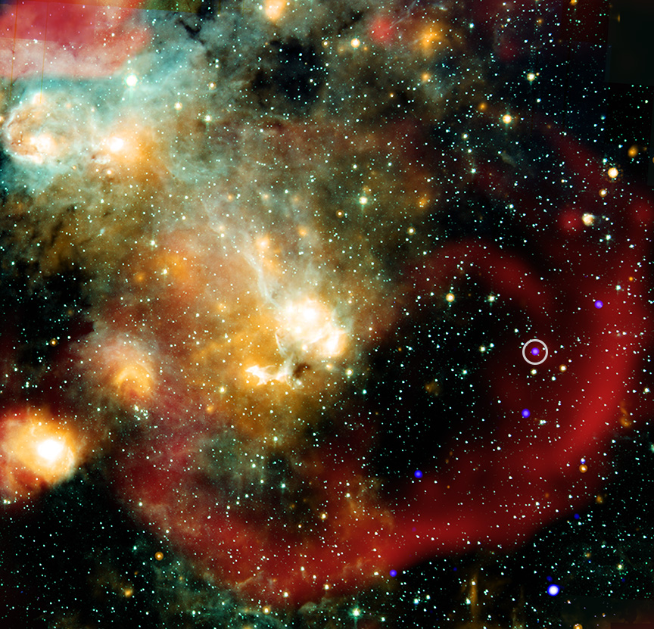

Chandra Science Highlight
Eccentric 'Star' Defies Easy Explanation, NASA's Chandra Finds
Astronomers have studied ASKAP J1832, which belongs to a class of objects that vary in radio wave intensity in a regular way over tens of minutes, called “long period radio transients."
This source is different, however, because it was discovered to regularly change in X-ray intensity as seen by NASA’s Chandra X-ray Observatory.
The X-ray and radio periods are both 44 minutes, and the source significantly brightened over months long timescales in both X-rays and radio waves. This is the first time that X-rays have been detected from a long period radio transient.
Researchers used the data to eliminate some explanations for ASKAP J1832, but are still trying to determine it nature, including whether it is a highly magnetic neutron star or white dwarf.
Distance estimate: 15,000 light-years
Credits: X-ray: NASA/CXC/ICRAR, Curtin Univ./Z. Wang et al.; Infrared: NASA/JPL/CalTech/IPAC; Radio: SARAO/MeerKAT; Image processing: NASA/CXC/SAO/N. Wolk
Instrument: ACIS
Reference: Wang Z. et al., 2025, Nature; arXiv.244.16606
More information: The detailed caption and other graphics materials are here:
https://chandra.harvard.edu/photo/2025/lprt/
In this composite image, X-rays from Chandra (blue) have been combined with infrared data from NASA’s Spitzer Space Telescope (cyan, light blue, teal and orange), and radio data from LOFAR (red). The long period radio transient ASKAP J1832 is circled. This radio and X-ray source appears to lie within a supernova remnant, the remains of an exploded star, identified by the large, curved region of radio emission in the lower right quadrant of the image. However, the research team determined that the proximity is probably a coincidence and the two are not associated with each other.
The Chandra X-ray Center is operated for NASA by the Smithsonian Astrophysical Observatory
May 2025

