Slide 1

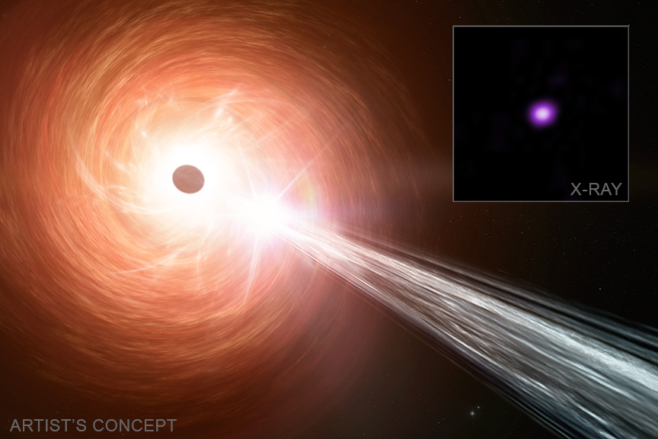

Chandra Science Highlight
NASA's Chandra Finds Black Hole With Tremendous Growth
A black hole powering a quasar less than a billion years old is growing at one of the fastest rates ever recorded.
Quasars are extremely bright objects that are powered by large amounts of matter funneling around and entering a supermassive black hole.
Astronomers used NASA’s Chandra X-ray Observatory to estimate the growth rate of the quasar RACSJ 0320-35, which exceeds the normal limit for these objects. It was discovered with other telescopes in 2023.
This discovery has implications for understanding how some of the Universe’s first generation of black holes formed.
Distance estimate: 12.8 billion light-years
Credits: X-ray: NASA/CXC/INAF-Brera/L. Ighina et al.; Illustration: NASA/CXC/SAO/M. Weiss; Image Processing: NASA/CXC/SAO/N. Wolk
Instrument: ACIS
Reference: Ighina, L. et al., 2025, ApJL, 990, L56: https://iopscience.iop.org/article/10.3847/2041-8213/aded0a
More information: The detailed caption and other graphics materials are here: https://chandra.si.edu/photo/2025/red6/
The main panel is an artist’s illustration of the quasar RACS J0320-35, located about 12.8 billion light-years from Earth. The black hole is surrounded by large amounts of material in a disk, which is generating copious amounts of light, making the quasar visible at its enormous distance. The illustration shows this disk of material as the red, orange and yellow swirls, and the black ellipse represents the black hole. Also shown is a jet of energetic particles blasting away from the black hole to the lower right. The quasar is shown in a Chandra image in the inset.
The Chandra X-ray Center is operated for NASA by the Smithsonian Astrophysical Observatory
September 2025

